Slide 1
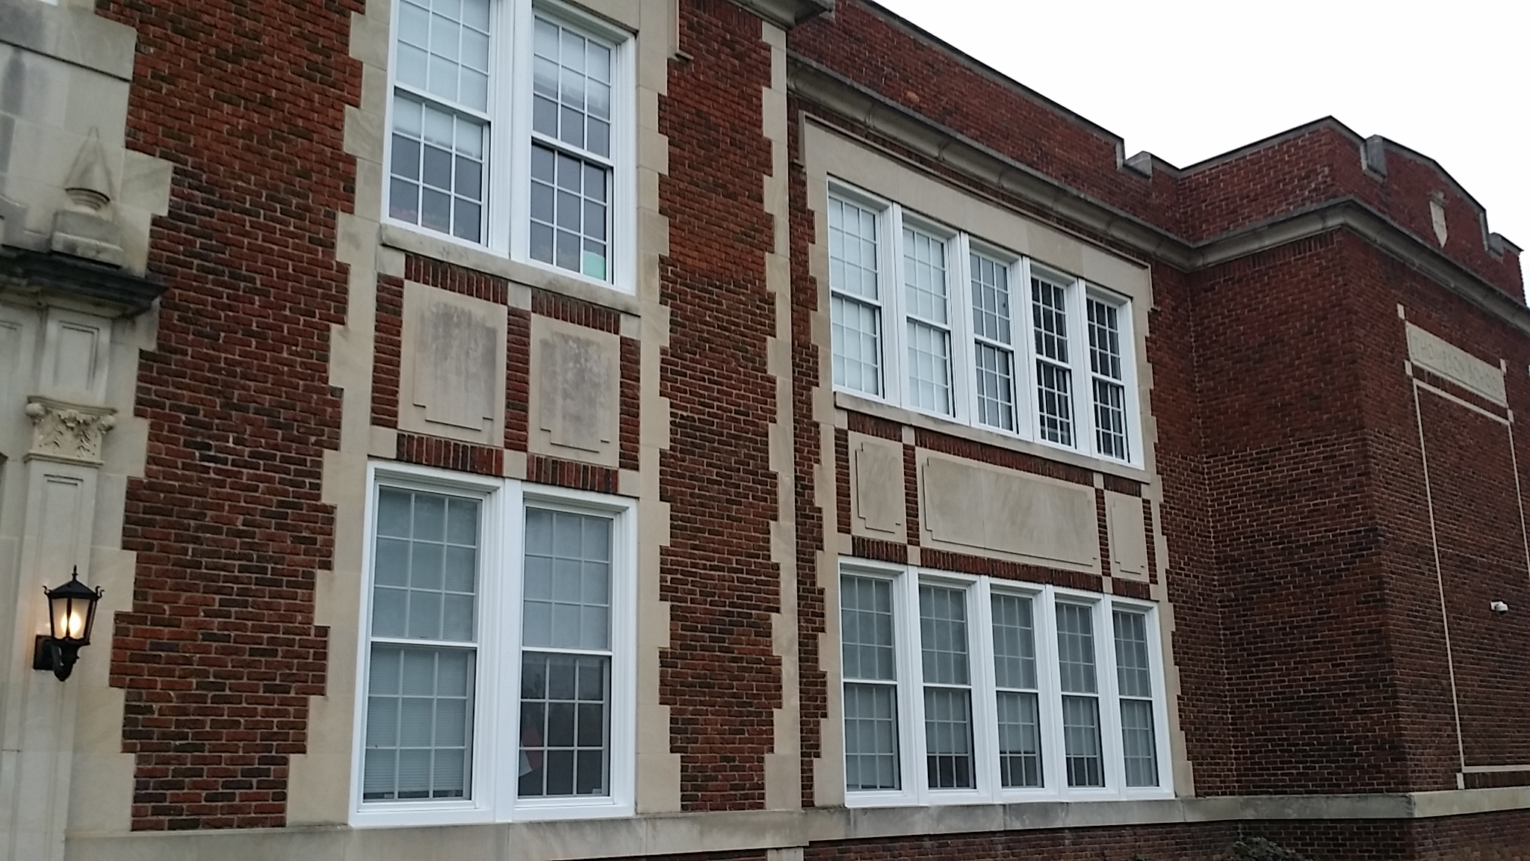
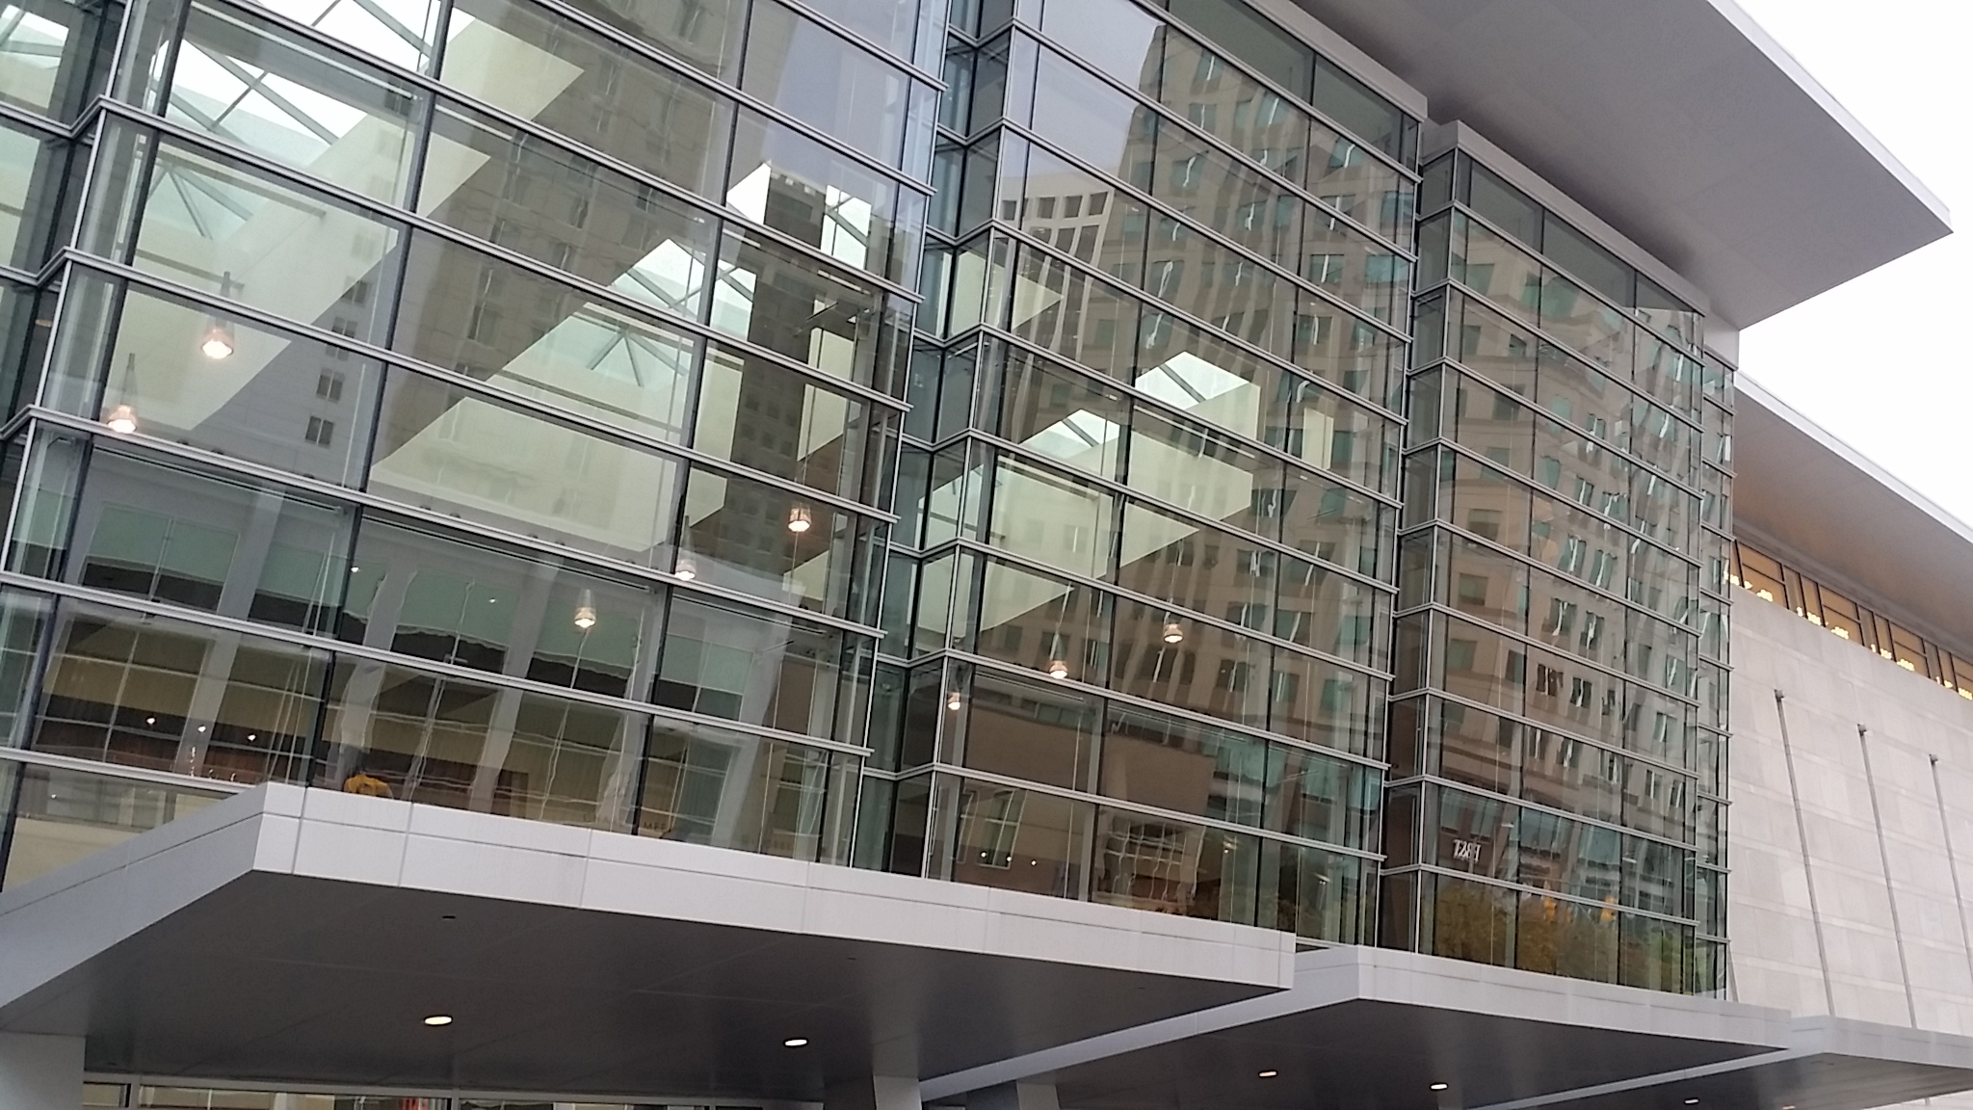
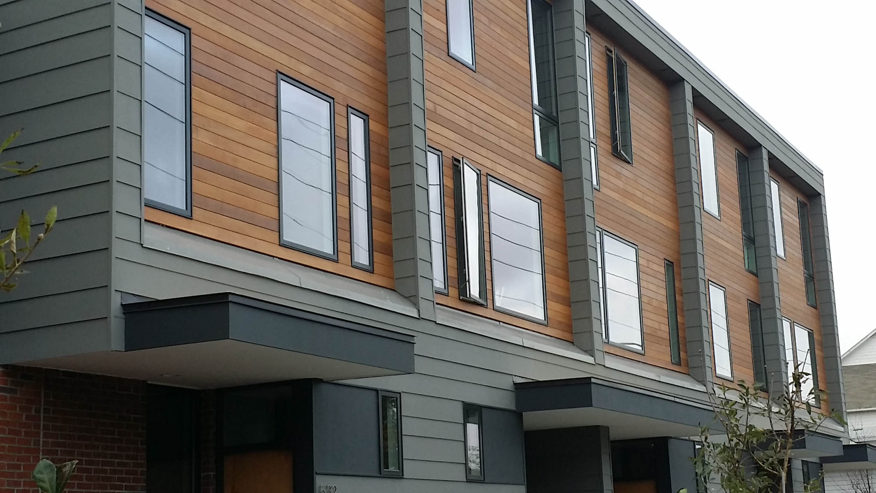
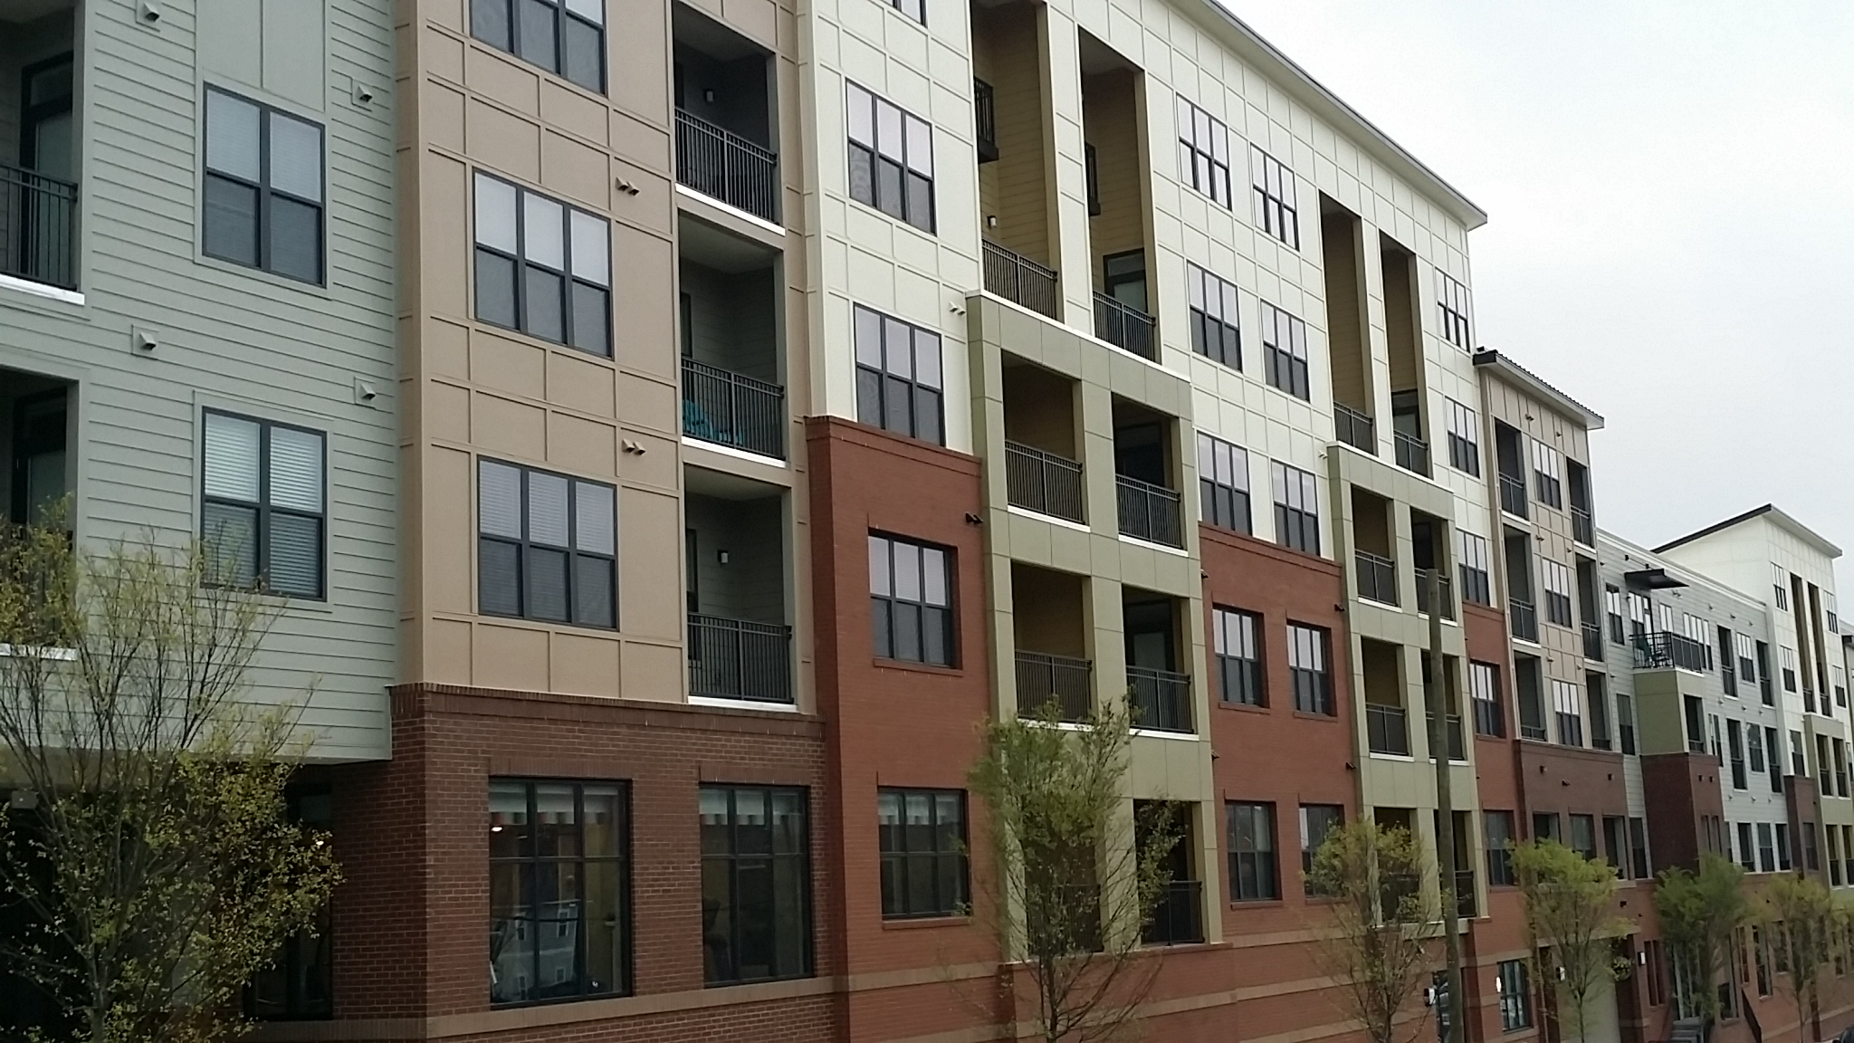
Retrofitting in Today’s Market
Retrofit Conference
October 9, 2018
Notes:
Thank you for the opportunity to present to you all today.

Slide 2
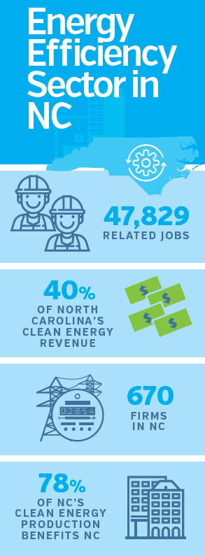
About NCBPA
North Carolina’s
Energy Efficiency
$15B
Building Performance
Green Building
Trade Association
1,500
Membership information available at www.BuildingNC.org
3.8%
STATE GDP CONTRIBUTION
Notes:
2 – About NCBPA
North Carolina Building Performance Association represents our state’s energy efficiency, green building and high performance construction industry. Energy efficiency is the largest sector of our state’s clean energy economy and employs more workers than all energy generation sectors combined.
While numbers you may have seen identify more than 80,000 jobs in our sector, for today’s purposes I’ll be referring to the set of numbers shown here to describe, in part, the size and impact of our industry:
We have 47,829 jobs
Roughly 1,500 companies generate $15B in annual revenue
This revenue contributes about 3.8% of the state’s GDP (note: $399B)
NCBPA’s goal is to increase the use of energy efficiency and building performance products and services in our state, most particularly in the built environment, to benefit residents, businesses, the economy and the environment.

Slide 3
Presented By
Ryan Miller
Founder & Executive Director
Ryan@BuildingNC.org
919-521-3385
Notes:
3 – Presented By
RMI report is a good resource referenced throughout. Focus is on Zero Energy Buildings but applies to retrofits and measures as well.

Slide 4
I AM NOT A CONTRACTOR
Notes:
I’m a market guy.

Slide 5
What’s Building Performance?
Notes:
We’re at the Retrofit Conference. I realize not everyone is focused on energy efficiency, green building or high performance construction. If not, I’d like to encourage you to look in that direction. If you are, I’d like to encourage you to get involved in a variety of initiatives available here in NC and across the country to increase the usage and value of building performance.
So what is building performance?
High performance results in comfort, sustainability and increased ROI. But, we found these benefits in energy efficiency. Making an existing building more energy efficient will yield these results.

Slide 6
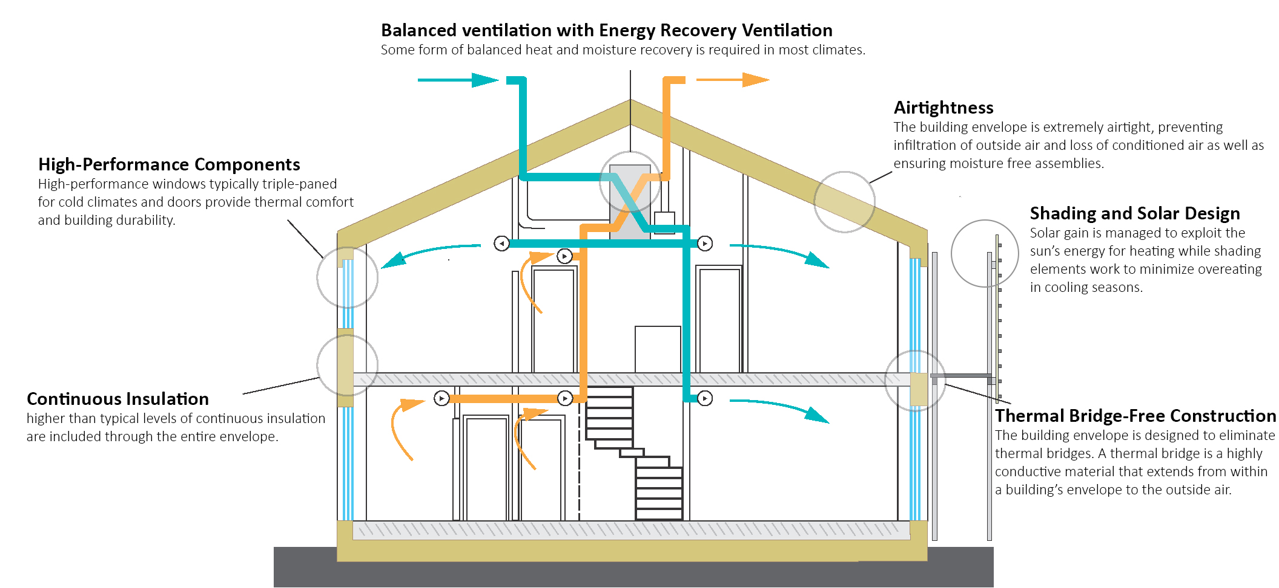
What’s the Performance Target?
Notes:
How do you get to energy efficiency? Well, instead of focusing on individual measures, let’s start all the way at the top-end best case scenario for a high performance building. There are two certifications or qualities of buildings that you want to look towards:
First is passive house or passive building. What this means is that the building is built new, or retrofitted, to use as little energy as possible. To do so, there are a lot of measures to take into consideration. Some will be easy in a retrofit, others very hard…

Slide 7
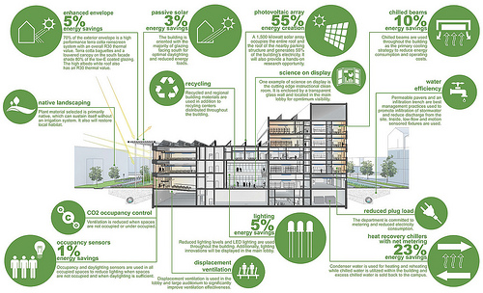
What’s the Performance Target?
Notes:
Second is net zero energy. Whereas Passive House seeks to lower your demand or need as much as possible, net zero seeks to get you to zero net energy usage no matter how you go – either 90% efficiency and 10% renewables or vice versa. There are what we call back-stops for actual certification programs – you can’t get a certification for a crappy leaky building with a bunch of solar, for example.
Putting buildings on the path to ZOT can carry value through multiple ownership transitions including short-term holding periods — each subsequent owner will benefit from the increased value of high-performing buildings, which retain value better than conventional buildings.
The geographic location of the portfolio is a significant factor in the economics of the ZOT approach. Areas with high utility rates and incentives, good solar resources, and lower labor rates will have more favorable economics.
The ZOT approach reduces carbon emissions over the 20-year period by 46% compared with business as usual.

Slide 8
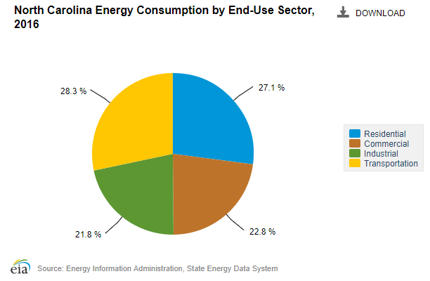
Why Building Energy Efficiency?
Notes:
And why buildings? Why building energy efficiency? North Carolina’s homes and buildings account for roughly half of our total energy consumption. Industrial buildings and facilities account for an additional 28%. Why energy efficient buildings? Because we have the most to gain using the least expensive methods available.

Slide 9
Why Building Performance?
Issues & Needs:
Evolving code changes
New technology, increased automation and connectivity
Smart appliances and mechanical systems increasing
Needs for greater durability and resiliency
Up-front costs increasing, high ROI needed for measures
Lots of construction, lots of inventory and competition
Solutions & Benefits:
Third-party verification
Hands-on design, installation and maintenance support
Software-based performance and energy modeling and testing
EE/HP buildings work better and last longer
EE/HP buildings carry more market value - when proven
EE/HP buildings stand out and carry more features and benefits

Slide 10
Energy Efficiency First
“We’re never going to get to our carbon targets or energy targets just by ramping up our solar production. We need to be efficient and reduce first. A dollar towards efficiency goes a lot farther than a dollar towards production. That’s what we do.”
Dylan Buonfrisco, REdesign.build
REDUCE
RECOVER
RENEWABLES
Notes:
And let’s add one more to the mix. For you environmentalists, starting with energy efficiency is the right way to go. Reduce first, recover what you can, then add renewables into the mix.

Slide 11
What’s the Potential?
Retrofit Conference
October 9, 2018

Slide 12
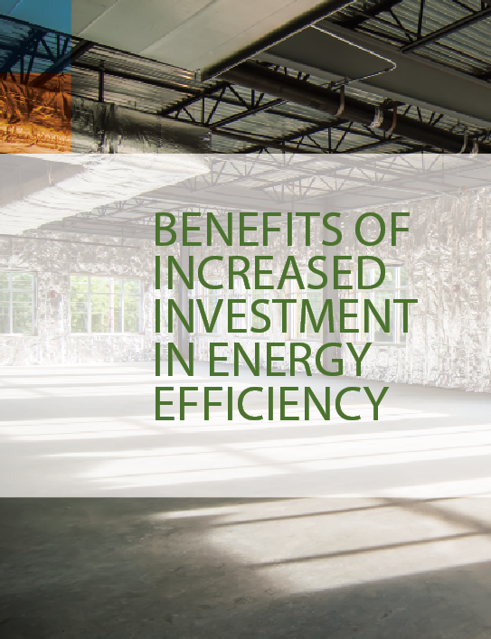
What’s the Potential?
$15B
1,500
3.8%
STATE GDP CONTRIBUTION
Notes:
Let’s find out…

Slide 13
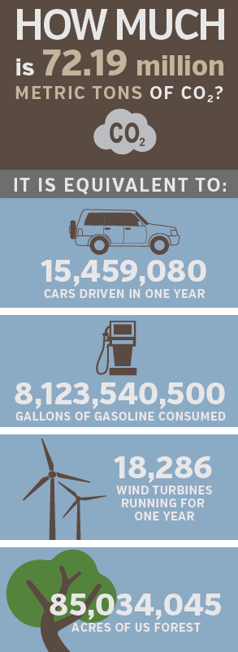
21.9 MILLION
$538 MILLION
$508 MILLION
63,789
4.6 MILLION
5%
$15.8B
2.4 BILLION
1,580
5,486
$129 MILLION
$3.0 BILLION
$4.2 BILLION
STATEWIDE ENERGY SAVINGS
26 MILLION
Notes:
18 – 5%
OVER THE NEXT 10 YEARS, a 5% reduction in energy usage through energy efficiency would:
Realize $538 Million in energy savings in existing homes, $129 Million in existing public buildings and $508 Million in existing Commercial and Industrial buildings. These are 10 years savings amounts for retrofit energy savings only.
New construction energy code improvements would yield an additional $3B in savings.
5% would also create 15,960 jobs, a 33% increase to the sector
Increase tax revenue by $750 Million
Create the need for 80 new local businesses or expansion for existing ones
Offset 21.9 Million tons of carbon
You can see some of the equivalents here. In one example, it would take 5,486 wind turbines running for a year to equal efficiency’s carbon reductions over 10 years.

Slide 14
43.7 MILLION
$1.1 BILLION
$1.0 BILLION
79,749
9.3 MILLION
10%
$16.5B
4.9 BILLION
1,650
10,972
$257 MILLION
$6.0 BILLION
$8.3 BILLION
STATEWIDE ENERGY SAVINGS
51 MILLION
Notes:
A 10% reduction in energy usage over 10 years through energy efficiency would:
Realize $1.1 Billion in energy savings in existing homes, $257 Million for public building retrofits and $1.0B in existing C&I buildings.
New construction code improvements would offer $6 Billion.
10% would create 31,920 jobs, increase tax revenue by $1.5 Billion and create the need for 150 new local businesses or growth for existing ones
10% would offset 43.7 Million tons of carbon, the equivalent of 51 million acres of forest

Slide 15
72.9 MILLION
$1.8 BILLION
$1.7 BILLION
101,029
15.5 MILLION
16.8%
$17.5B
8.1 BILLION
1,750
18,286
$420 MILLION
$10.0 BILLION
$13.9 BILLION
STATEWIDE ENERGY SAVINGS
85 MILLION
Notes:
And lastly, our analysis identified 16.8% as the most energy savings potential available for North Carolina, less than the latest federal study of 18.4%. Using this number as our energy savings target… we would:
Realize $1.8 Billion in energy savings in existing homes, $420 Million in public building retrofits and $1.7 Billion in existing C&I buildings
New construction code changes would contribute $10 Billion in energy savings.
We would create 53,200 jobs and increase tax revenue by $2.5 Billion from $15B
By the way, $17.5B of annual revenue accounts for 4.4% of NC’s $399B GDP
That’s a 0.6% increase in annual GDP for the state.
16.8% would also create the need for 250 new local companies or expansion for existing ones
And, it would offset 72.0 Million tons of carbon, the equivalent of 15.5 million cars driving for a year.

Slide 16
To Achieve 16.8% Energy Savings
 | 5% Savings | 10% Savings | 16.8% Savings
Energy Saved (BTU) | 99 Trillion | 199 Trillion | 331 Trillion
Energy Code Savings $ | $3.0 Billion | $6.0 Billion | $10.0 Billion
Public Buildings Savings $ | $129 Million | $257 Million | $429 Million
Commercial Buildings Savings $ | $508 Million | $1.0 Billion | $1.7 Billion
Residential Buildings Savings $ | $538 Million | $1.1 Billion | $1.8 Billion
Total Savings $ | $4.2 Billion | $8.3 Billion | $13.9 Billion
Total Investment $ | $798 Million | $1.6 Billion | $2.7 Billion
Net Savings $ / % | $3.4 Billion 526% | $6.7 Billion 519% | $11.2 Billion 515%
Notes:
The investment needed to save those 331 Trillion BTUs would be around $2.7 Billion but save $13.9B and net $11.2 Billion, a 515% return on investment.

Slide 17
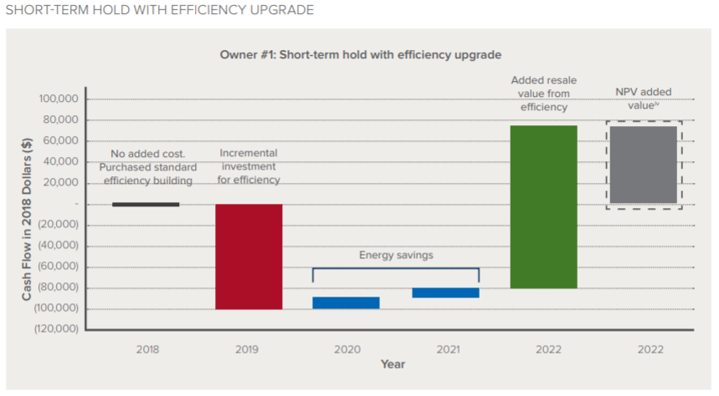
Risk and Return on Investment
Notes:
So increasing a state’s investment, or your company’s investment, in energy efficient buildings carries a high energy savings potential. But, bringing it back to your business and that of your customer, what is the risk and what is the reward to you?
Here’s an example from the RMI report on how building energy efficiency holds value in both short and long-term holds. This is a short-term example.
Reducing risk. When many diverse projects are deployed as part of a single investment strategy, the failure of any individual project does not jeopardize the investment as a whole. Additionally, risk can be actively mitigated by diversifying energy investments by combining more conservative opportunities with higher-risk and return endeavors
Increasing ROI. For example, a theoretical portfolio owner could invest in an energy project with a 10-year payback that reduces her energy costs by 20%, and resell the building in year two for an efficiency project IRR of 25%. The added resale value of the building equals the annual energy cost savings divided by an anticipated capitalization rate (typically around 6%), which makes this project immediately economical. This is earlier than the simple payback period of the energy project but would still deliver enough profit from the sale of the building to repay the owner. This is consistent with industry research showing a 13% increase in resale value for green buildings.

Slide 18
What are the Barriers?
Retrofit Conference
October 9, 2018

Slide 19
Building Owner & Operator Education

Slide 20
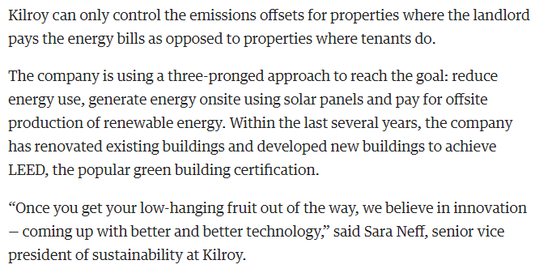
Up-Front Costs vs. Benefits
Notes:
Vs. short and long-term benefits for tenants, occupants, owners, operators each
The realities of the industrial environment are:
Limited time to do anything beyond putting out proverbial fires
Limited funding to do anything not directly related to production
The uncertainty of operating next year, next month, or even tomorrow.

Slide 21
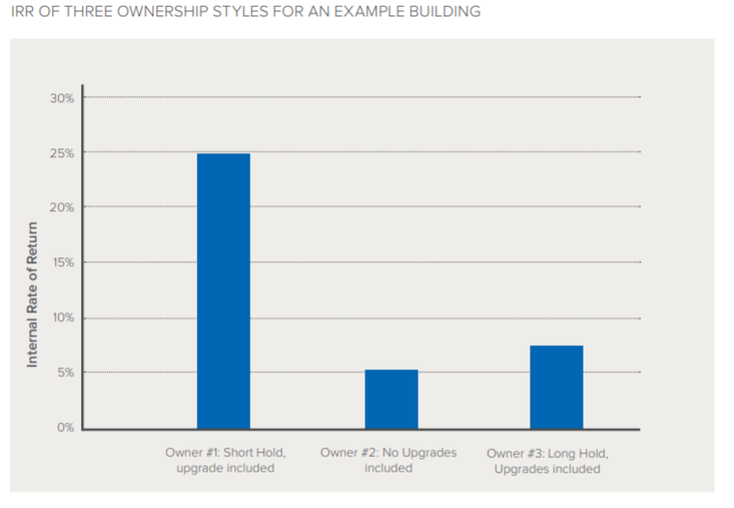
Short-Term ROI Needed
Notes:
Particularly in industrial --- can’t shut down a plant for a day! Well, compare short hold vs. long hold for EE upgrades… from RMI report

Slide 22
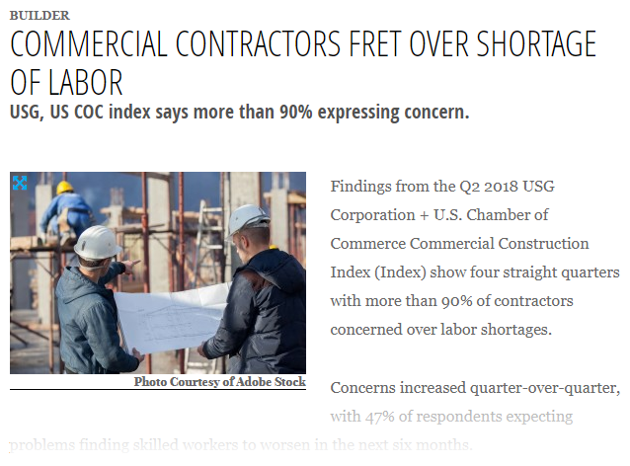
Workforce Concerns
Notes:
Lack of skilled labor, uneducated and retiring code officials… you don’t need another obstacle!

Slide 23
Market Valuation
Notes:
What if your project doesn’t appraise? Either the building retrofit or the value provided to specific measures?

Slide 24
Real Estate Portfolios
Notes:
Do high performance buildings fit into current or future commercial real estate portfolios?

Slide 25
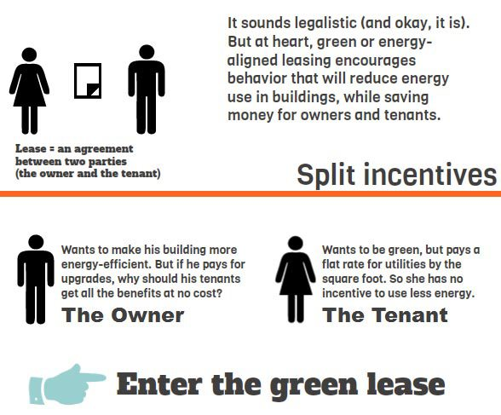
The Split Incentive
Notes:
What if owners don’t want to invest in EE/performance upgrades when tenants pay for utility bills?
This approach is also well suited for portfolio owners that have lease mechanisms in place to recover the cost of efficiency projects. This is relatively straightforward in a gross lease,ix because the building owner can pay for upgrades and pass along the amortized costs to tenants. For portfolios with triple net leases,x this could be an opportunity to modify the lease by extracting the energy costs from the operating expenses and having tenants pay a fixed base rent premium or “energy charge.” The amount of this charge could be based on the building’s past energy costs or could be similar to energy bills for surrounding properties. This allows the landlord to directly benefit from energy savings and could be an added value to tenants because they can have monthly fixed energy costs and reduced exposure to volatile utility costs

Slide 26
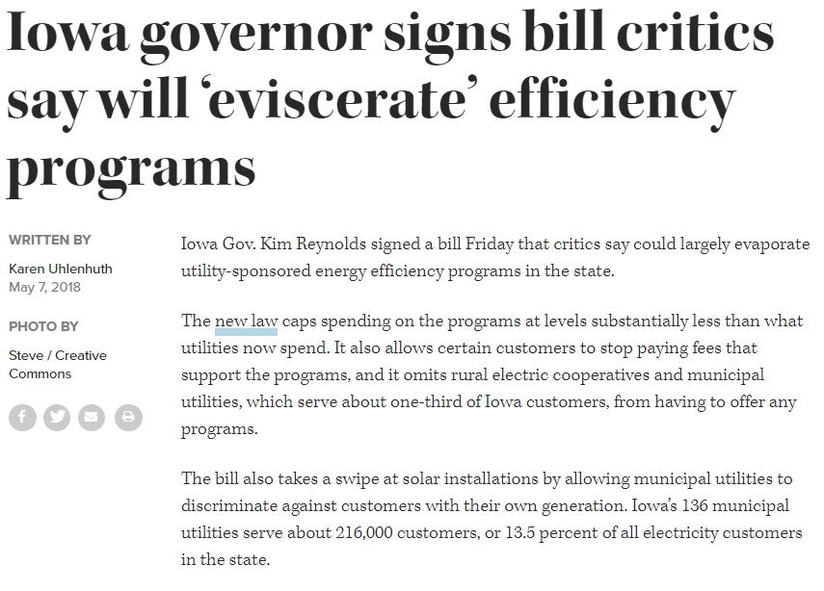
Industrial Opt-Out Info
Notes:
Pull from Stowe and NCSU slides

Slide 27
What Trends and Solutions Drive Growth?
Retrofit Conference
October 9, 2018

Slide 28
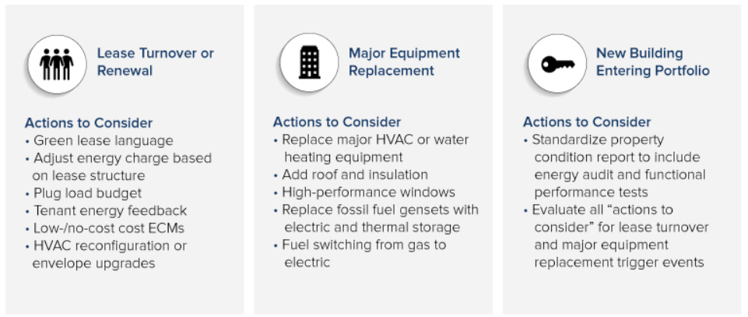
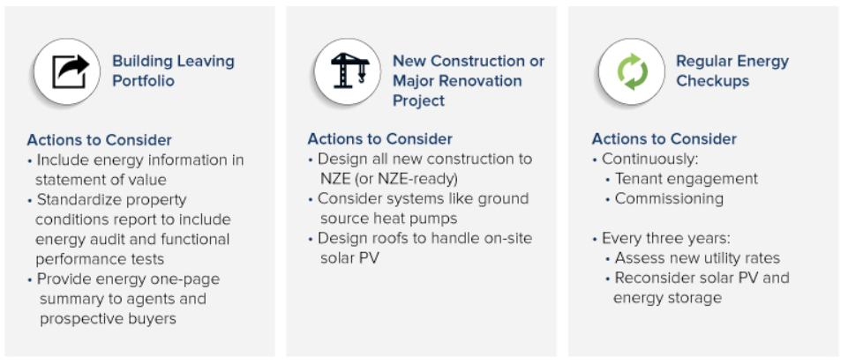
Net Zero Energy Buildings
Notes:
Easier in new construction, do-able in major retrofits. Help address clean energy, carbon reduction and other goals. Charts from RMI report. A zero-over-time (ZOT) approach sets commercial building portfolios on a financially viable path to achieve net zero energy. The ZOT approach helps portfolio owners and managers right-time deep energy efficiency, renewable energy, and energy storage projects with life-cycle event triggers for investment.ii

Slide 29
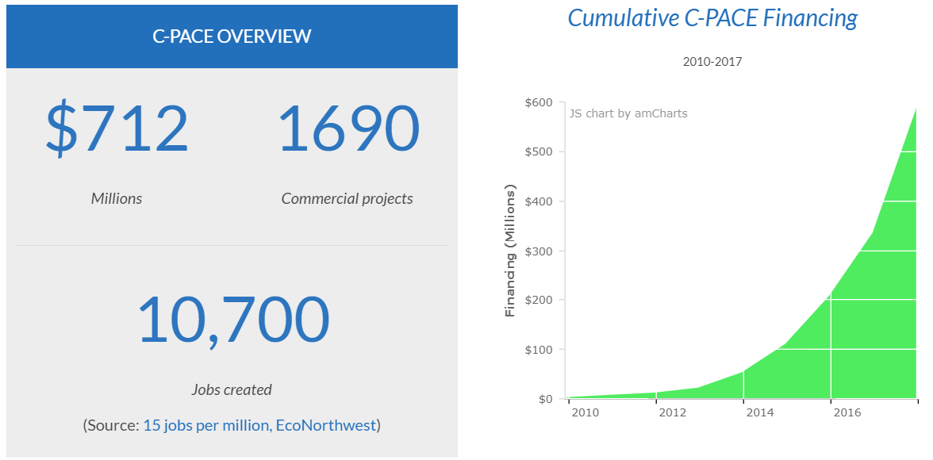
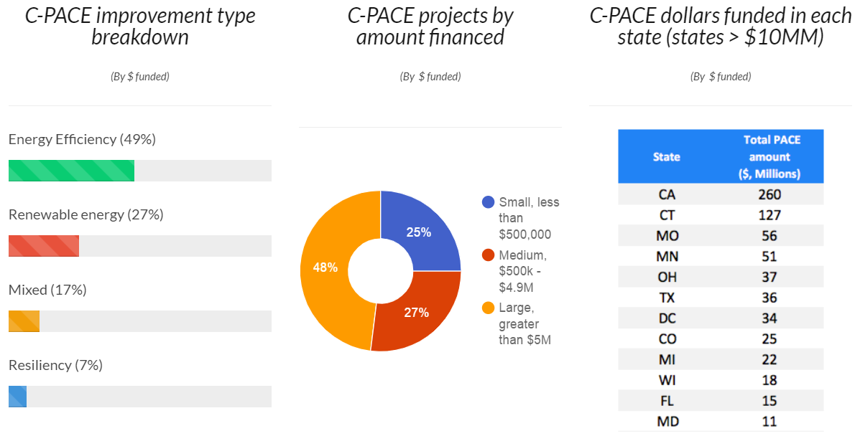
Innovative Project Financing: C-PACE
Notes:
Will is the expert! Just a mention here.

Slide 30
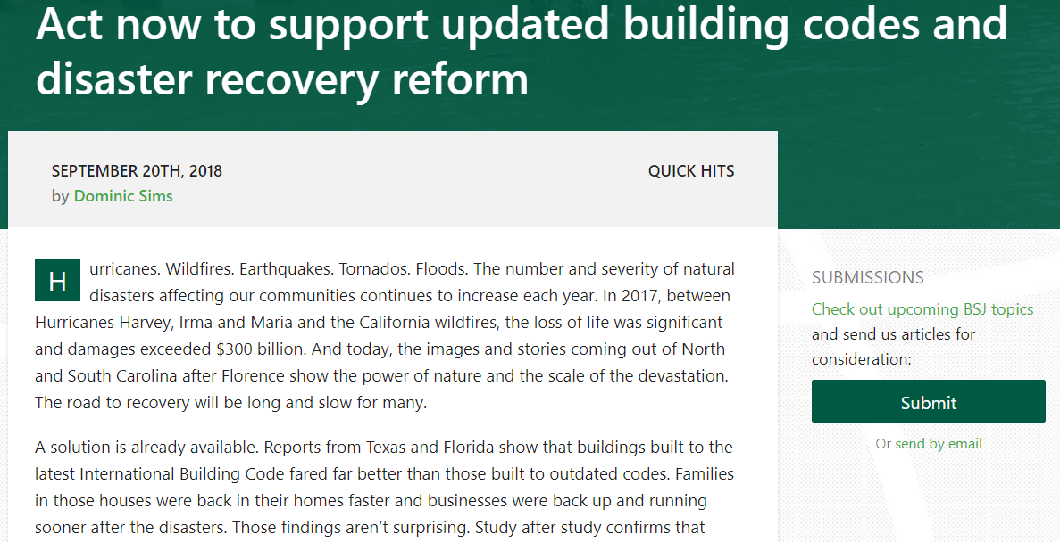
Disaster Recovery & Code Reform
Notes:
Impact of Florence
How commercial, institutional and industrial retrofits can make them better

Slide 31
Envelope Commissioning
Notes:
Recommissioning (RCx) is a systematic process of tuning existing building controls and equipment to improve building performance, increase occupant comfort, and save energy. RCx is an effective, lowcost first step to reduce energy consumption and cost immediately in a building. Analyses of RCx projects for existing buildings show a median cost of $0.27 per SF, energy saviT
Continuous commissioning (or active energy management) has similar goals (resolve operating problems, improve comfort, reduce energy use, and identify retrofits for existing commercial buildings) but is a lighter-touch and more continuous intervention. Continuous commissioning relies on building management systems and fault-detection diagnostics to continuously track a building’s operation and identify issues. It can save more money than RCx efforts (because issues are caught sooner) and it can be less expensive to implement.

Slide 32
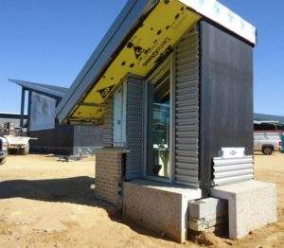
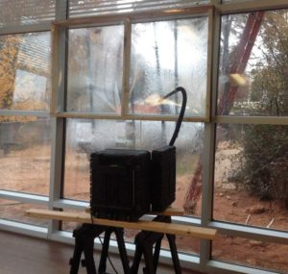
Building and Energy Code
Notes:
Envelope commissioning and testing requirements

Slide 33
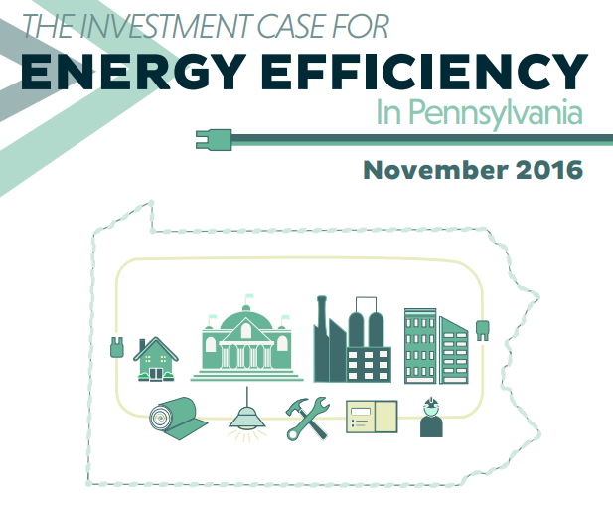
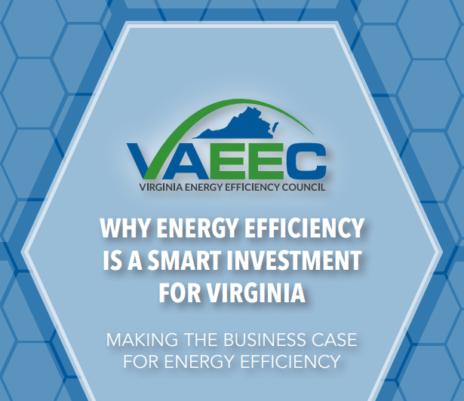
State Policy Investments & Mandates
Notes:
11 – Other States?
So you might be asking yourself … Have other states done this? Yes. Pennsylvania, Virginia and Arkansas are taking major steps to integrate energy efficiency into their energy policies and programs, but also to make a strategic investment in a large industry with a localized workforce.
North Carolina can establish policies that make investments more attractive by reducing cost barriers, lowering risk, and reducing regulatory compliance costs.
Funding opportunities may include direct cash incentives, grants, rebate programs and performance-based incentives, where contractors and builders like the ones that we represent are paid based on their energy saving performance. Tax incentives, loans and financing programs, green banks, energy efficient mortgages and support for Commercial PACE Financing, which uses local government funds only as a passthrough, are available as well. Energy services performance contracting is a great example – more on that one in a minute.
But no matter what investment methods North Carolina takes, the strategy remains the same: investing in less creates more energy savings, more jobs, more economic development and more environmental benefits.

Slide 34
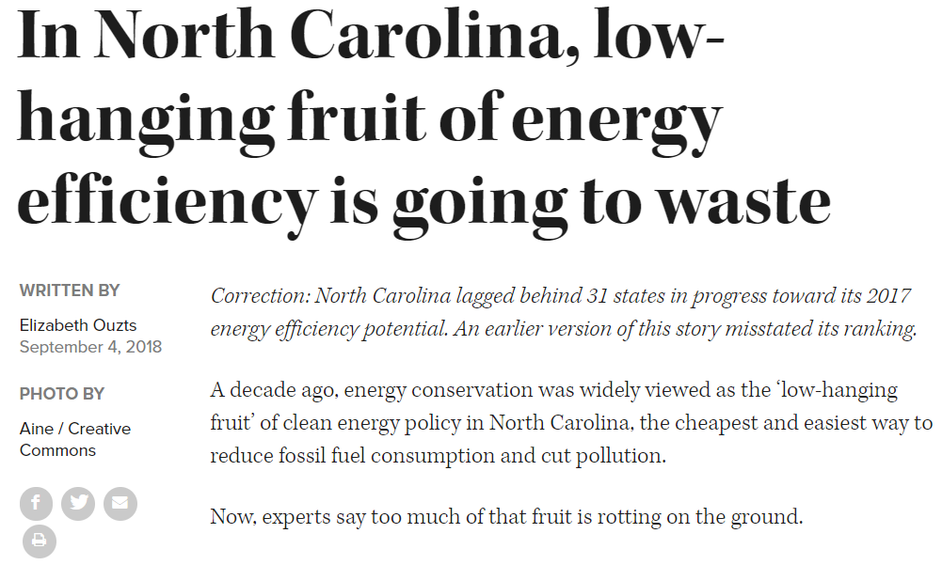
What’s the Starting Point?
Notes:
Policy and majority interest is in EE – but we talk about Building Performance.
For a market to grow, you need to be able to measure the baseline. That’s what we’ve been doing in NC.

Slide 35
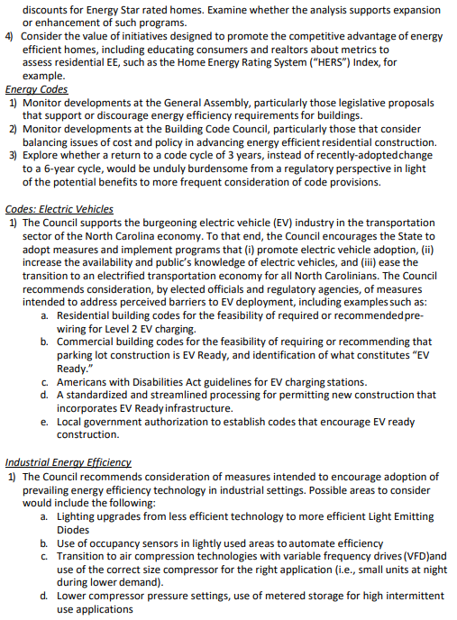
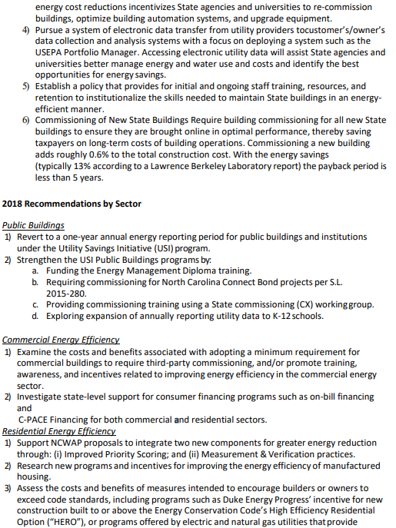
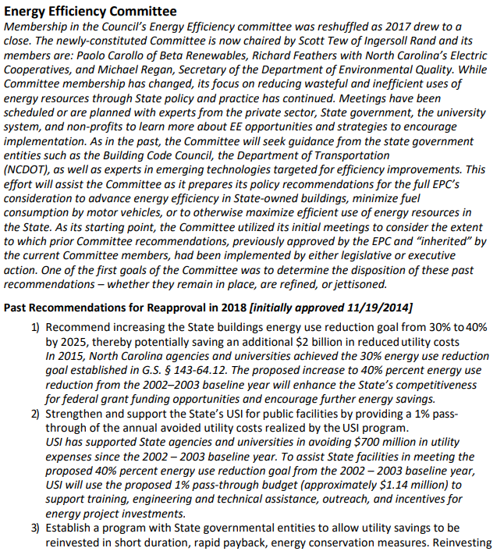
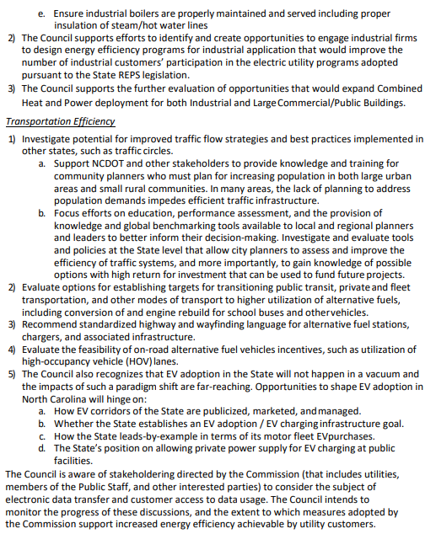
Building EE Policy Support in NC
Notes:
4 – EPC Report
I’d also like to thank and recognize the Council members, the Lt. Gov, DEQ staff and the Energy Efficiency Subcommittee Chaired by Scott Tew for 26 of the 33 recommendations in your recent report having to do with energy efficiency. 20 of the 26 recommend policy development related to building energy efficiency. In my opinion, this is an accurate reflection of the policy focus that our state should be taking to first reduce the amount of energy we need before investing in more energy generation, no matter the source.

Slide 36
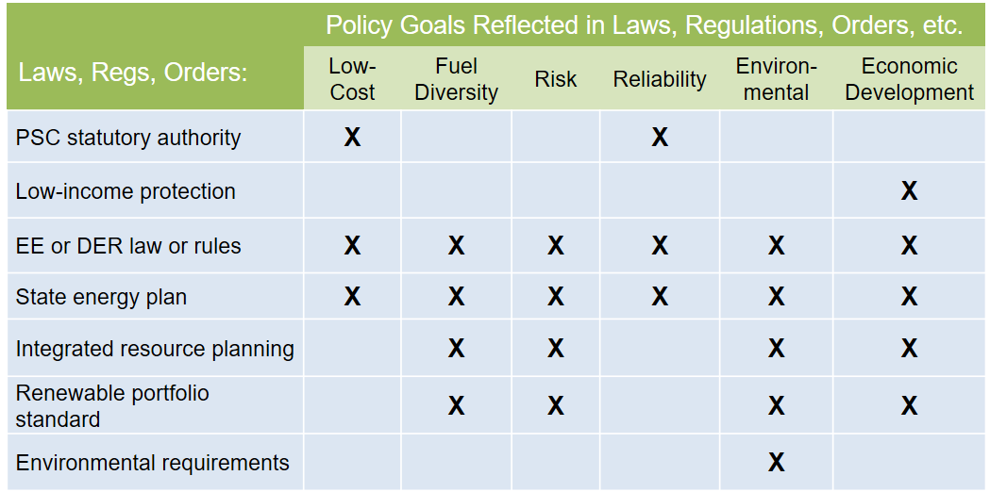
Utility Cost Effectiveness Testing
Notes:
What this is – strictly for improving building EE utility programs

Slide 37
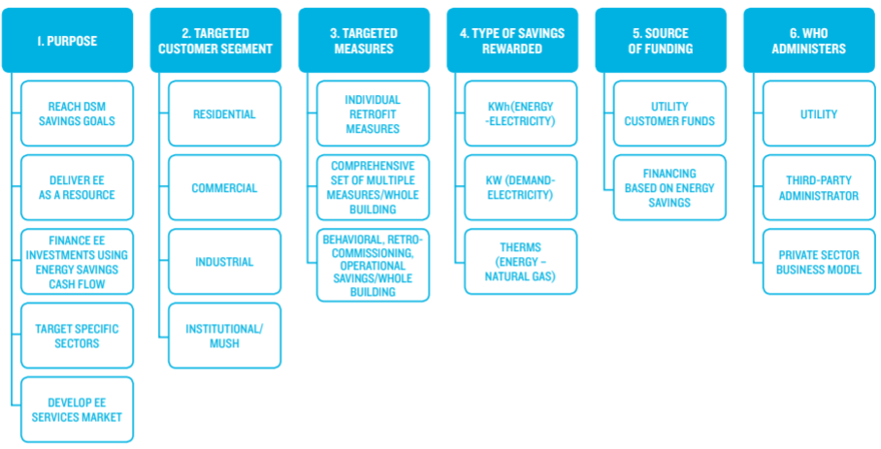
Pay-For-Performance Programs
Notes:
Pull from Stowe and NCSU slides

Slide 38
Case Studies
Retrofit Conference
October 9, 2018

Slide 39
Host Hotels’ Capital Planning Process

Slide 40
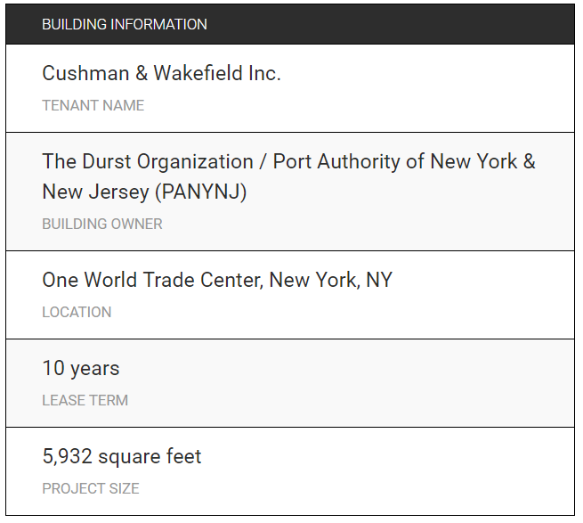
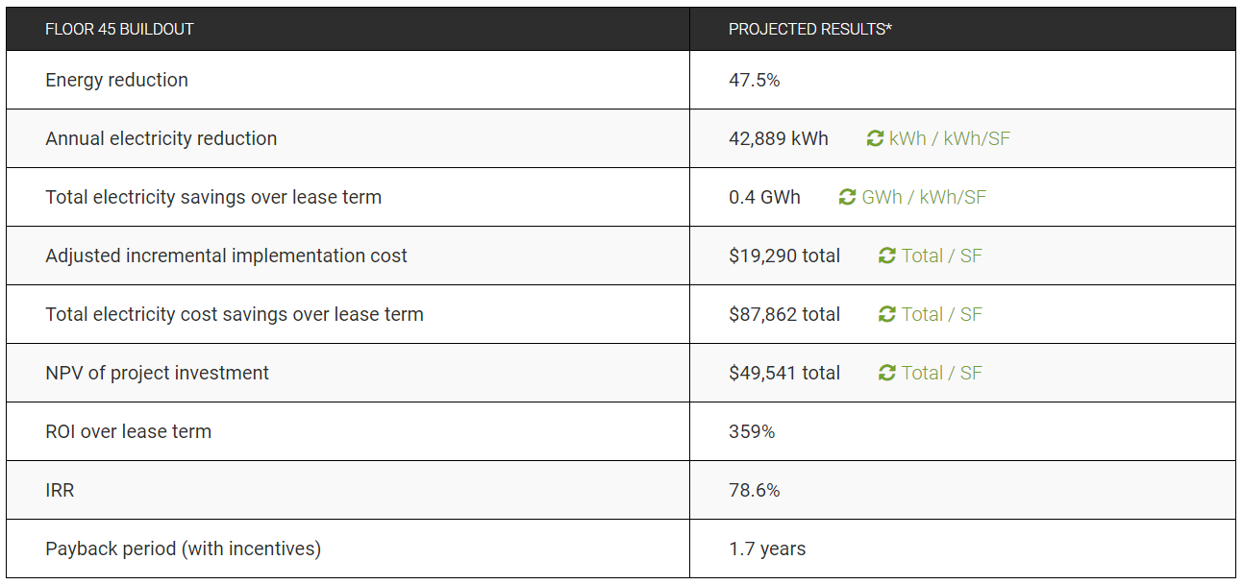
Cushman & Wakefield
https://tenantenergy.uli.org/case-study/cushman-wakefield-inc/

Slide 41
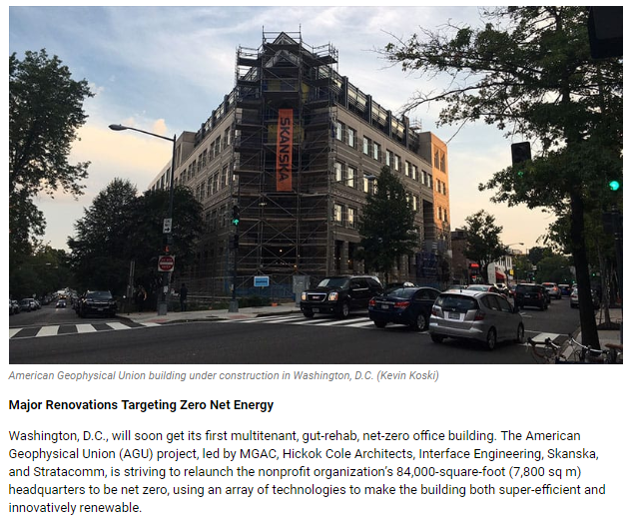
American Geophysical Union in DC

Slide 42
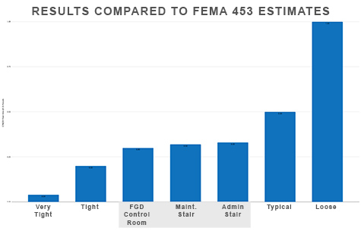
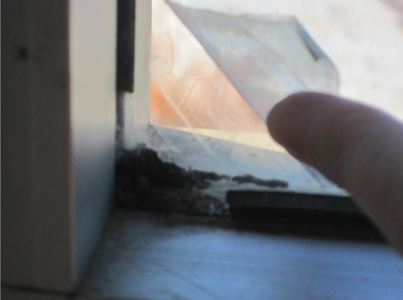
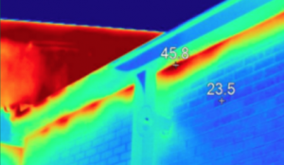
HPBS Case Studies
Notes:
HPBS – Find Meghan!
Top right – Industrial safe haven air leakage testing delivers 70% average reduction in air infiltration rates after air sealing measures applied.
Bottom left – degrading window film and window gaskets. Resolving these issues, installing efficient lighting and sealing air leaks recommended with 29% energy reduction estimate.
Bottom right – IR image of school building in NC showing gaps in the air barrier system that caused significant heat loss and moisture intrusion.

Slide 43
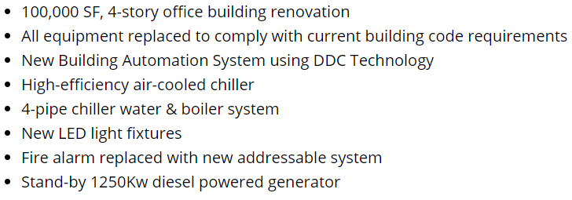
Optima Engineering Retrofit

Slide 44
Combustion Waste Heat
Notes:
Mike Stowe from Advanced Energy recently presented on how many industrial buildings in NC could benefit from retrofit upgrades that would convert 20% of combustion heat from waste/loss to useful purposes. His estimates equate to enough energy to power 210,000 NC homes!

Slide 45
Steps to High Performance Retrofits
Retrofit Conference
October 9, 2018

Slide 46
Steps to High Performance Retrofits
Research.
Understand options.
Set goals.
Add-on renewables, storage and other energy options as needed.
Identify rebates, incentives and financing options.
Design and build.
Commission.
Work with experts.
Formulate baseline metrics.
Align with goals.
Monitor performance.
Analyze data.
Make improvements.
Keep monitoring.
Plan for efficiency and performance first.
Incorporate valuation best practices.
Notes:
Make these images???

Slide 47
Hire an Expert
Hire a Building Scientist:
HVAC
Envelope/enclosure
MEEP commissioning
Use an Energy Services/Performance Contractor:
ESCOs are paid through actual energy and water savings after retrofit projects take place, lowering the up-front cost to little or nothing to the owner.
High Efficiency HVAC, controls and automation are key.

Slide 48
Specific Retrofit Projects
Replace natural gas appliances and systems with electric.
Doing so provides greater flexibility for benefiting from improvements to electricity-based energy efficiency and renewable energy sourcing
Incorporate solar-capable roofing for future applications.
Replace major HVAC and water heating systems with high efficiency.
Add high performance roofing, siding and insulation.
Replace windows – when the time is right.

Slide 49
Considerations for Rentals
Use green leases and create a feedback loop for tenants on energy and utility usage.
Adjust energy/utility charges based on conservation/usage.
Install low-/no-cost Energy Conservation Measures (ECMs).
Lighting retrofits are high ROI.
Promote increased comfort and customer satisfaction.
Install sub-meters so that tenants can be charged for the electricity they actually use and benefit from savings.
Notes:
ECMs:
• Adjusting mechanical and lighting schedules to match current building occupancy. • Adjusting heating, cooling, and lighting zones so consistently unoccupied zones aren’t conditioned, ventilated, or lit. • Engaging and educating tenants—consider a “turn it off” campaign or provide actual use data to inform all occupants, not just the individuals who pay the bills. • Controlling your entry and exit (keep doors closed, encourage revolving door use). • Using window blinds to reduce h

Slide 50
Additional Resources
Retrofit Conference
October 9, 2018

Slide 51
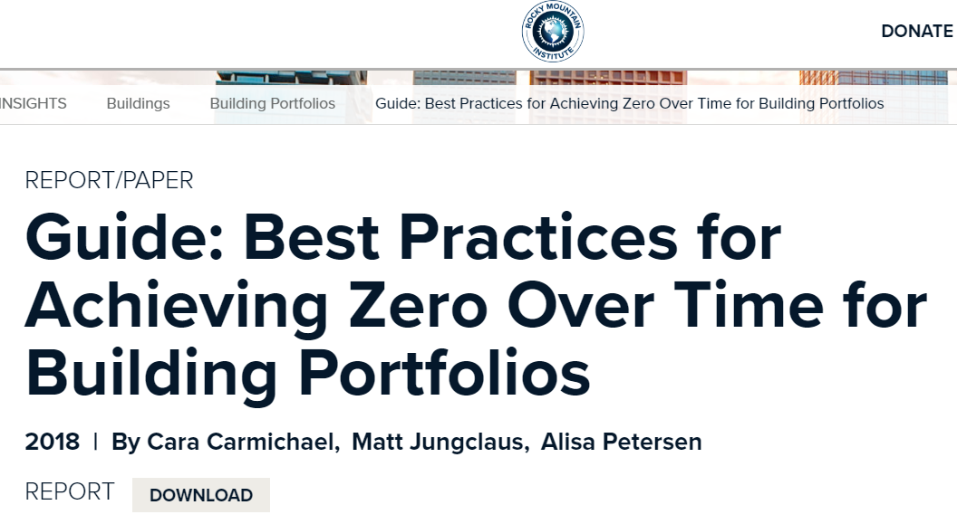
Net Zero Energy Buildings

Slide 52
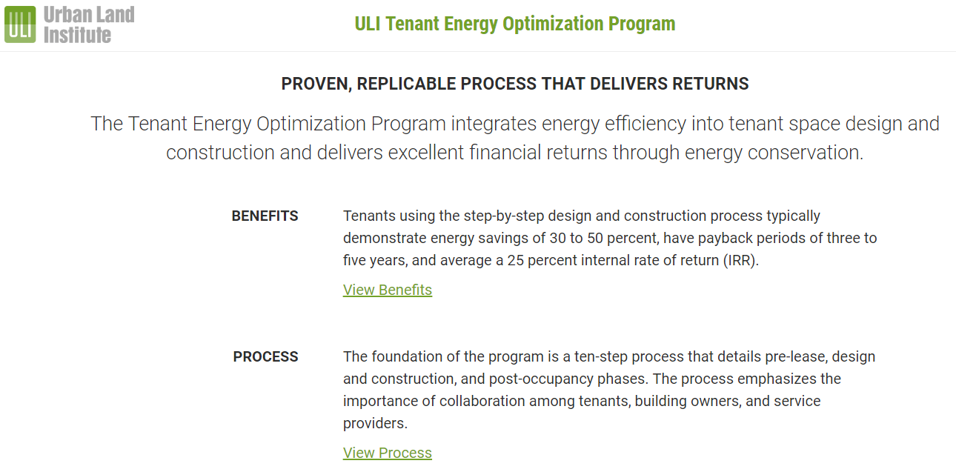
Tenant Energy Optimization Program
Notes:
From ULI

Slide 53
Pay-For-Performance Programs
Notes:
Pull from Stowe and NCSU slides

Slide 54
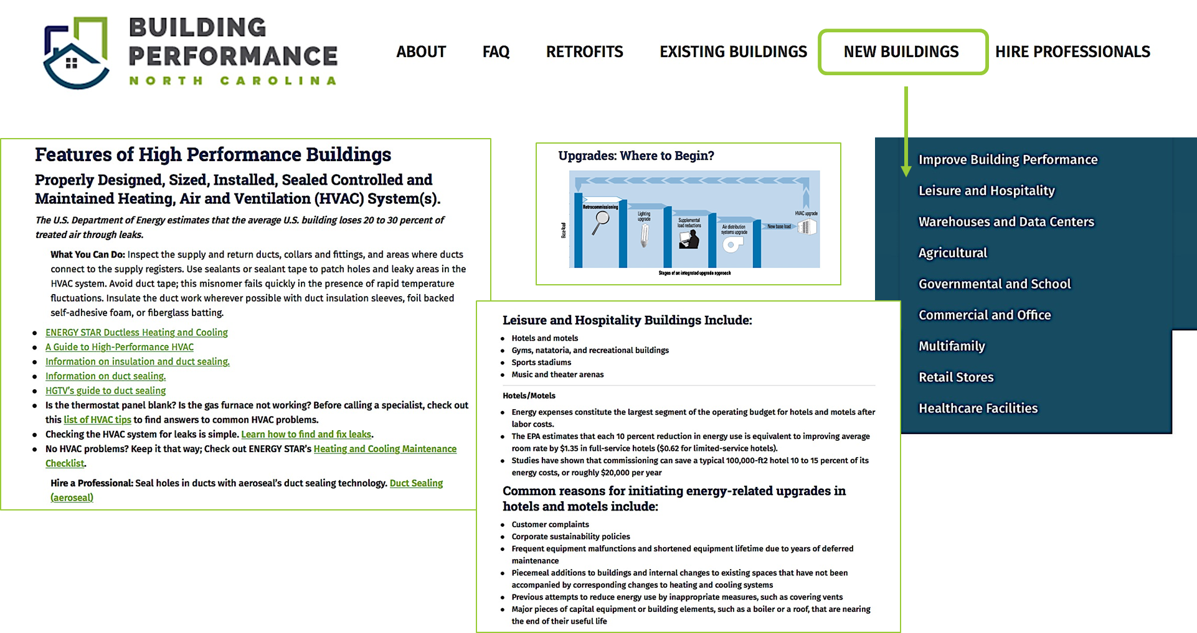
BuildingPerformanceNC.org

Slide 55
Retrofitting in Today’s Market
Retrofit Conference
October 9, 2018
Notes:
Thank you for the opportunity to present to you all today.

